Slide 1
Identifying a Drilling State Machine
Prepared by Nicole McCarthy
For Deere Development Company, LLC.
June 11, 2025

Slide 2
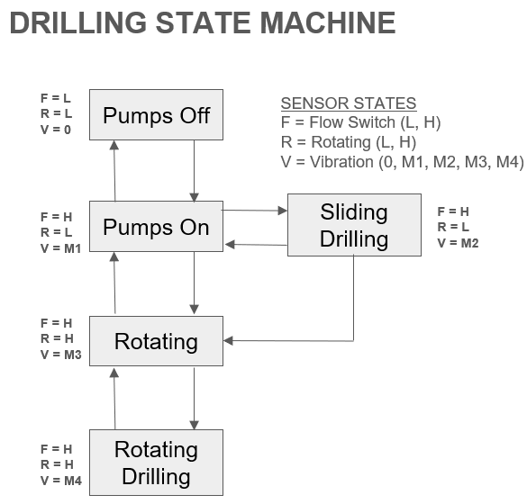
The Problem
Software on drilling tools can be optimized by knowing what state the tool is in
Deere Development Company (DDC) has outlined the Drilling State Machine seen here to fulfill their software needs
Indicating Drilling Parameters
Flow
Rotation
Vibration
Weight on Bit (WOB)

Slide 3
The Data
Well | Run | Date In | Date Out | MD In | MD Out
Flybar 1 WB | Run 7 | 12/2/2024 | 12/4/2024 | 10582 | 13222
 | Run 8 | 12/4/2024 | 12/8/2024 | 13222 | 17880
Flybar 1 WC | Run 6 | 12/9/2024 | 12/10/2024 | 10175 | 10287
 | Run 7 | 12/10/2024 | 12/11/2024 | 10287 | 10713
 | Run 8 | 12/11/2024 | 12/12/2024 | 10713 | 12088
Flybar 2 WC | Run 5 | 11/23/2024 | 11/28/2024 | 10960 | 16782
Provided by DDC from real runs on oil rigs
Includes the following items:
Time
Depth
Gallons per Minute (GPM) (Flow)
RPM
Axial and Lateral Vibration (at Motor and Pulser)
Weight on Bit (WOB)

Slide 4
Related Previous Work: Supervised
Method | Random Forest (RF)
Industries | Oil & Gas
Applications | Geological Formation Prediction
Data | Sensor Data

Slide 5
Related Previous Work: Unsupervised
Method | Hidden Markov Model (HMM) | Gaussian Mixture Model (GMM) | Hierarchical Density-Based Spatial Clustering for Applications with Noise (HDBSCAN)
Industries | Oil & Gas | Oil & Gas Statistical Research | Manufacturing Natural Language Processing
Applications | Pump Jack Performance Analysis | Pump Jack Performance Analysis Oil Spill Image Classification | Robotic Welding Monitoring Record Classification
Data | Large dataset Time-series Sensor Data | Large dataset Time-series Sensor Data | Real Time Sensor Data

Slide 6
Proposed Work
Hidden Markov Model Training and Testing
Gaussian Mixture Model Training
HDBSCAN Training
Clustering Methods Evaluation
Random Forest Training and Testing

Slide 7
Progress
Preprocessing
Forward Filled
Only included necessary parameters
Segmented rigs into runs
Warehousing
CSVs for each Rig and Run

Slide 8
Challenges/Lessons Learned
Initially planning to use data labels
Found they were unreliable
Pivoted to unsupervised methods for creating labels followed by supervised method for faster implementation
Also decided to include HMM, not a traditional clustering algorithm for testing, due to direct application of method

Slide 9
Evaluation
Train on Flybar 1WB and 1WC
Test on Flybar 2WC
Statistical Analysis
Domain Knowledge
1 Run
5 Runs in Total
Inter/Intra Cluster Similarity Indices

Slide 10
Next Steps
Modeling
- HMM
- GMM
Evaluation
- HMM testing
- HDBSCAN
- Clustering evaluation
- RF implementation

Slide 11
Conclusion
Project to be completed by end of June
Methods of building and testing prioritized:
HMM
GMM
HDBSCAN
RF
Evaluated for heuristic sense and inter/intra cluster similarity
Completion will allow for better implementation of MWD software
Leading to more cost effective, safe, and time efficient drilling techniques

